Slide 1


Slide 2

Making cents
Welcome
Overview
Budgeting Basics
Gambling Literacy
Debt Management
Becoming a Froogle Shopper “Easy Ways to Save”
Needs Vs Wants
How to protect Yourself from Fraud

Slide 3
Budgeting
Benefits of Budgeting
Control your financial future
Achieve your life goals
Provide for yourself and your family
Be a smarter consumer
Reduce stress and sleep better at night
Be more confident in your ability to manage your finances and daily living expenses
Notes:
This slide is repeated from slide # 2 only excluding the problem gambling prevention section.

Slide 4




Budgeting
KEY PARTS OF A BUDGET ARE:
Income
Expenses
Balance:
the difference between the two
Budgeting
What is a Budget?
Keep every receipt
Record expenses in a notebook
Review bank and credit card statements.
Make a list of irregular expenses
(gifts, car or home repairs, vacations)
Total expenses at the end of the month.
Do this for 3 months.
Notes:
Ask: What is income? Response: Income is the money we earn or make.
Ask: What is an expense? Response: the amount of money we spend.
Ask: What is the balance? Response: Balance is the amount that is left over. You calculate the amount of money you earn, or your income and subtract the total of your expenses, or spending. The balance will show either a surplus, which is money you have saved or a deficit which is how much money you overspent.

Slide 5
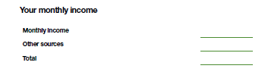
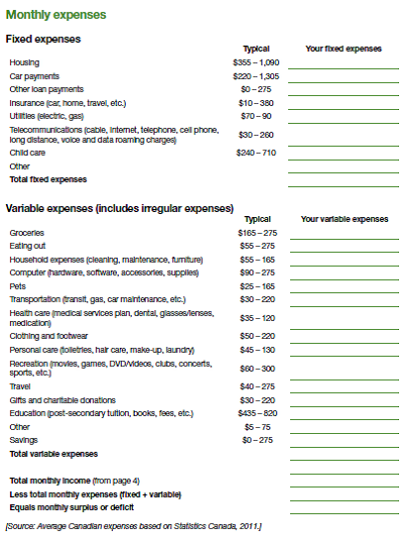
Budgeting
Exercise 1:
Simplified Budget
Notes:
Allow 30-45 minutes. Can use grocery prices from Appendix II or allow participants to give their best ‘guess’ on spending amounts.

Slide 6
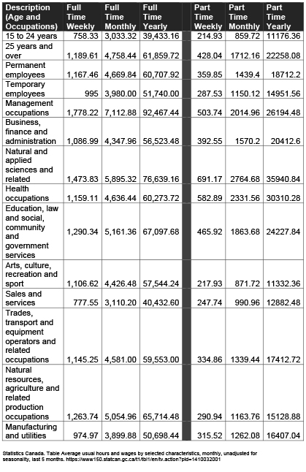
Budgeting
Average Income

Slide 7
Budgeting
Handbook Page 2:
Living Expenses
Your monthly income
Monthly income
Other sources
Total

Slide 8
Budgeting: worksheet
Exercise 1:
Expenses
Handbook page 3

Slide 9
$ per item times/day times/week Total per week UPDATED
Item
Coffee (take-out or drive thru)
Donut/Muffin/Bagel
Breakfast (take out or restaurant)
Lunch (take out or restaurant)
Supper (take out or restaurant)
Alcohol
Smoking (i.e. Cigarettes)
Extra Phone and or phone Data fees
Movie/ Date night
Gas for non-essential use
Impulse Buy Items (non-essential items)
Other Items
Lottery, Scratch, Nevada Tickets
Bingo or Casino
Other Gambling (sports, draws, etc)
Total A: Grand Total per Week
Total B: Total Per Month: Multiply above x 4
Total C: Total per year: Multiply Total per Month x 12
$ $
$ $
$ $
Notes:
Point out that during this exercise the key question to ask is ‘What is your latte factor?”
Ask: What are some examples?
Instruct: Please go to the next page in your handbook to the worksheet called “Your Latte Factor”. Think of those little pleasures that you indulge in, mark them on the worksheet and put a best guess as to how much you spend every week and month on your own Latte Factor. We will have about 7 minutes to complete this.
Advise when there are 2 minutes remaining.
Ask: Take a look at your total. Are you surprised at how much your latte factor is costing you?
Advise: We will be using coming back to this worksheet later.

Slide 10

Budgeting
-$125
X 4
-$500 per month
in debt (in the hole)
-$500
X12
-$6,000 per year
-$6,000
X 5 years
-$30,000 in debt
Understanding Debt
If your balance is -$125 per week X 4 weeks per month =
-$500 per month in debt (in the
hole).
-$500 per month X 12 months in a year = -$6,000 per year.
-$6,000 per year X 5 years =
-$30,000 in debt.
Notes:
If your balance indicates a negative amount (–) then there is a need to make some adjustments to find ways to reduce your daily, weekly and monthly spending. Example. If your balance is -$125 per week X 4 weeks per month = -$500 per month X 12 months = -$6,000 per year that you are going into debt. At this amount of ongoing debt, within 5 years you will be in the hole an amount of -$30,000. Ways to save are covered in the next section of this workshop.
Assistance is available if you need more individualized help. Sources have been provide to you in Appendix ___ - Financial Supports.

Slide 11

GAMBLING AWARENESS
Gaming & Gambling
Awareness Program
WHAT IS GAMBLING
Gambling is when someone risks losing something of ‘VALUE’, usually or belongings, and winning or losing is decided by chance. Usually this is money or belongings but your time away from work, your family, friends and responsibilities also has great value.

Slide 12


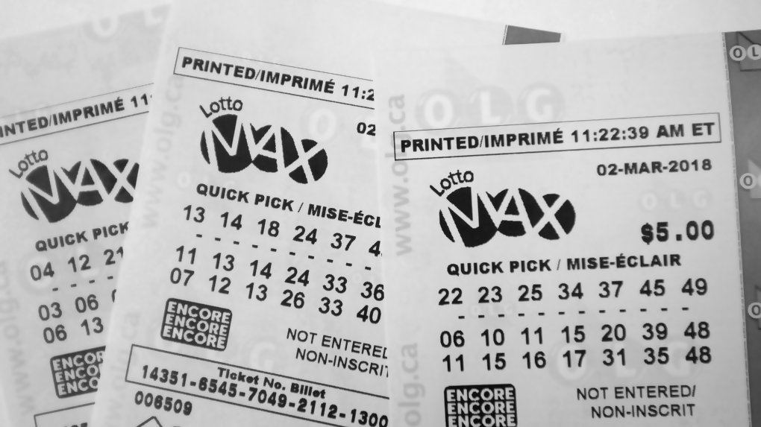





GAMBLING AWARENSS
Forms of Gambling
Lottery & Scratch Tickets
Bingo
Casino Games
Online Poker
50/50 money draws (like the ones you buy at kids’ sporting events or weddings)
Penny Tables
Door prizes or draws at events
Notes:
Ask: What is income? Response: Income is the money we earn or make.
Ask: What is an expense? Response: the amount of money we spend.
Ask: What is the balance? Response: Balance is the amount that is left over. You calculate the amount of money you earn, or your income and subtract the total of your expenses, or spending. The balance will show either a surplus, which is money you have saved or a deficit which is how much money you overspent.

Slide 13

GAMBLING AWARENESS :
Gambling Pre Screen
HAVE YOU EVER?
Participated in any form of gambling?
Felt guilty about gambling?
Felt the need to cut down on your gambling?
Borrowed money to gamble?
Spent more money gambling than you intended?
Felt annoyed by others criticizing you about your gambling?
Ever lost time from your work or school or time way from family events as a result of your gambling?

Slide 14

GAMBLING AWARENESS :
IF YOU OR A LOVED ONE SHOW ARE SHOWING RISKY BEHAVIOUR OR ALREADY HAS A PROBLEM WITH GAMBLING, THERE IS A 24 HOUR TOLL-FREE PROBLEM GAMBLING HELPLINE.
1-888-230-3505
For more information on MNO’s Gaming & Gambling Awareness Program contact on one of the MNO’s healing and wellness staff or our Provincial Coordinator at ggap@metisnation.org

Slide 15


Smart consumer:
Managing Your Cost of Living
BIG IDEA: Be proactive in reducing your costs. By Shopping around and negotiating with service providers you can get better deals and save money. Small behaviour changes will result in big savings.
Notes:
Here is a guaranteed way to start saving $100 per month:
Take a lunch to work 3 x per week
Take public transit to work and only use the car once a week
Cell Phone – get a pay as you go plane instead of monthly
No more Drive Thru Coffee! $2 per cup X 2 cups per day X 5 days per week = $20/week X 4 weeks/month = $80 X 12 months/year = $960 per year in savings! That is enough to buy a lot of groceries or Christmas gifts.

Slide 16
The smart consumer
BIG IDEA: You can be proactive in reducing your costs.
AREAS FOR SAVING
Check your bills
- Spot mistakes and overcharges
- Less interest fees
Negotiate better plans (bank, phone, etc)
Pack a lunch
Reduce impulse buying
Notes:
Here is a guaranteed way to start saving $100 per month:
Take a lunch to work 3 x per week
Take public transit to work and only use the car once a week
Cell Phone – get a pay as you go plane instead of monthly
No more Drive Thru Coffee! $2 per cup X 2 cups per day X 5 days per week = $20/week X 4 weeks/month = $80 X 12 months/year = $960 per year in savings! That is enough to buy a lot of groceries or Christmas gifts.

Slide 17


The smart consumer
Ways to Save:
Negotiate Better Plans
Activity
Call each service provider. Ask for the customer retention or loyalty department. Ask these questions.
How can I cut back my monthly bills?
Do you have a better plan for me?
If so what is the timeframe?
While I be put on contract for any new deals?
Can I bundle services to save money?
Can I avoid interest or late payment penalties?
Notes:
Use Sticky Notes. Ask everyone to write down at least 1 way to reduce impulse buying them put them up on the flip chart.

Slide 18

The smart consumer
Ways to save: Bank Fees
Activity
Things to Ask:
What am I paying in monthly service charges?
How much am I paying for ATM fees?
Can I save by doing more banking online?
Am I eligible for a low-fee deal if I am a student?
Can I get a reduced fee if I keep a minimum balance?
Can you suggest a better plan for me?
Notes:
Use Sticky Notes. Ask everyone to write down at least 1 way to reduce impulse buying them put them up on the flip chart.

Slide 19


THE SMART CONSUMER
Reduce
Impulse Buying
What is the difference between a want and a need?
What is impulse buying or spending?
ACTIVITY #3 Buyer Beware: Write down at least 3 things on how to reduce or avoid impulse buying
Notes:
In this section we will be learning about the importance of the financial impact of our wants vs needs.
Ask: What is the difference between a want and a need? Open Discussion
Instructions: Using flipchart, engage participants to answer the questions and open discussion for idea sharing. In small groups, please go to one of the flip charts. Identify someone to the be the ‘writer’. There are 3 questions. Each group will respond to the question, write down idea and each group will report at the end. You will have 5 minutes to complete this.
NOTE: If a smaller group or time is being pressed, this activity can be done completely by the facilitator however engaging participants to do the writing is recommended.

Slide 20
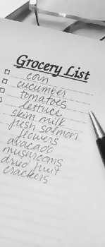
The smart consumer
Reduce Impulse Buying
Bring a shopping list and only buy what you need.
Avoid unintended trips to the mall.
Do not go to online buying or auction sites.
Pay cash or cheque for purchases and only carry the
cash you are willing to spend.
Reduce available credit on credit card and line of credit.
Leave credit cards at home.
Sleep on it before making an impulse purchase.
Take baby steps and cut costs gradually.
Notes:
Here is a guaranteed way to start saving $100 per month:
Take a lunch to work 3 x per week
Take public transit to work and only use the car once a week
Cell Phone – get a pay as you go plane instead of monthly
No more Drive Thru Coffee! $2 per cup X 2 cups per day X 5 days per week = $20/week X 4 weeks/month = $80 X 12 months/year = $960 per year in savings! That is enough to buy a lot of groceries or Christmas gifts.

Slide 21
The smart consumer
Ways to save: Phone Costs
Activity
What am I paying for land line and cell phone?
How much do my long-distance calls cost?
Can I bundle services together to save?
Can I switch suppliers to save money?
Do I have a contract? When does it expire?
Have I called my suppliers to ask how to cut costs?
Notes:
Use Sticky Notes. Ask everyone to write down at least 1 way to reduce impulse buying them put them up on the flip chart.

Slide 22
The smart consumer
Ways to save: Bundling
Activity
Keep an eye on your existing plans and be sure you get the best deals out there as they are offered.
Every 4 months, be sure to check your service providers to see if they have a new customer or existing customer promotion or discount.
If they do, and it is not in your existing plan, contact them and request the savings be applied to your account.
Speak to a CUSTOMER RETENTION supervisor or manager if you need to and negotiate a better deal.
Notes:
Use Sticky Notes. Ask everyone to write down at least 1 way to reduce impulse buying them put them up on the flip chart.

Slide 23
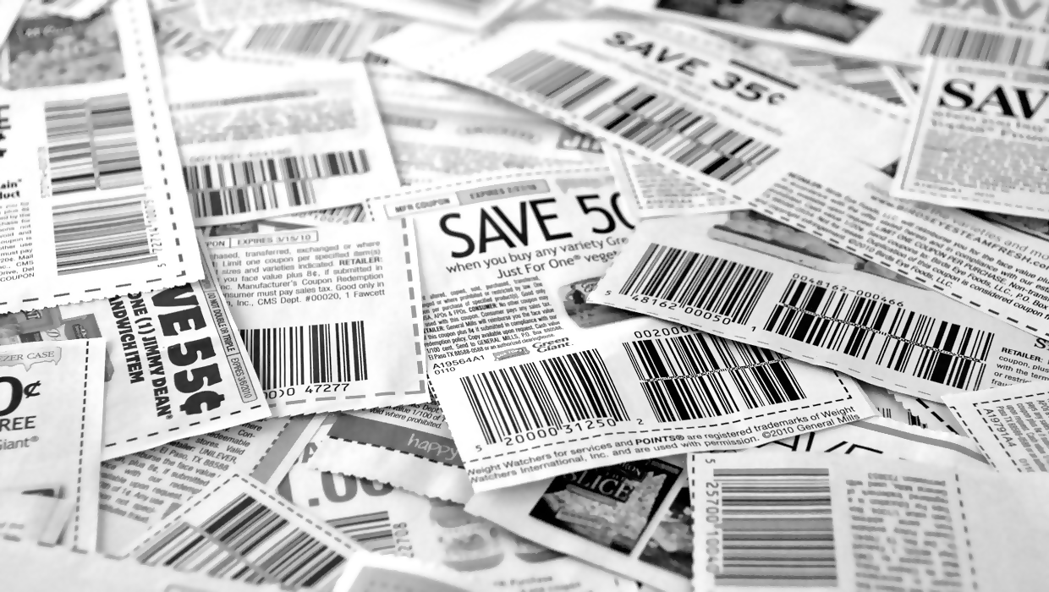
The smart consumer
MORE WAYS TO SAVE
Look at printed flyers or flyer apps for your phone, highlight the items on sale that you need for the week.
Look for and use coupons.
Do price matching (more on this in the Froogle Shopper section).
Plan meals around weekly sale items at the grocery store. i.e. You were thinking of having broccoli but it is full price but carrots are on sale. Broccoli is going to be on sale next week. Get the carrots this week and the broccoli next week instead.
Notes:
Here is a guaranteed way to start saving $100 per month:
Take a lunch to work 3 x per week
Take public transit to work and only use the car once a week
Cell Phone – get a pay as you go plane instead of monthly
No more Drive Thru Coffee! $2 per cup X 2 cups per day X 5 days per week = $20/week X 4 weeks/month = $80 X 12 months/year = $960 per year in savings! That is enough to buy a lot of groceries or Christmas gifts.

Slide 24

The smart consumer
HOW TO MAKE THE MOST OF YOUR FOOD BUDGET
Eat breakfast at home.
Avoid drive thrus including coffee shops
Bring your lunch, drinks and snacks (and coffee) to work or school
“Veg out” on meatless meals once a week or more.
Cook one big dish on weekends and freeze.
Shop with a buddy at discount supermarkets and split quantities.
Notes:
Ask your participants if they can come up with ways to save money on food purchases. Use flip chart titled SMART CONSUMER. Use the first bullet as an example to get the conversation started. You can read these out loud (to make the workshop go faster) or use flipcharts and ask participants to fill them out. Review this list with them to be sure all is included at the end.

Slide 25
The smart consumer
HOW TO MAKE THE MOST OF YOUR FOOD BUDGET
Set a weekly budget and stick to it.
Bring a shopping list and only buy what you need – do not buy anything that is not on your list, even if it on clearance – you do not NEED it today.
Don’t shop on an empty stomach
Make your grocery list ahead of time and make your meals with food items that are on ‘SALE’ each week.
Avoid buying ‘junk food’ or prepackaged frozen dinners
Notes:
Ask your participants if they can come up with ways to save money on food purchases. Use flip chart titled SMART CONSUMER. Use the first bullet as an example to get the conversation started. You can read these out loud (to make the workshop go faster) or use flipcharts and ask participants to fill them out. Review this list with them to be sure all is included at the end.

Slide 26



Budgeting:
The Smart Consumer
HOW TO CUT $142/MONTH OF SPENDING
CATEGORY
BEHAVIOR CHANGE
DAILY SAIVING
WEEKLY SAIVING
MONTHLY SAIVING
ANNUAL SAIVING
Take lunch 3 x week
$5/day /
($8 saved –
$3 cost)
$15
$60
$720
Take transit, not car, once
a week
$13 ($12 parking + $3 gas - $2 transit fare)
$13
$52
$624
Pay as you go vs monthly
$1 ($55/mo. - $25 = $30)
$7
$30
$360
Notes:
Here is a guaranteed way to start saving $100 per month:
Take a lunch to work 3 x per week
Take public transit to work and only use the car once a week
Cell Phone – get a pay as you go plane instead of monthly
No more Drive Thru Coffee! $2 per cup X 2 cups per day X 5 days per week = $20/week X 4 weeks/month = $80 X 12 months/year = $960 per year in savings! That is enough to buy a lot of groceries or Christmas gifts.

Slide 27

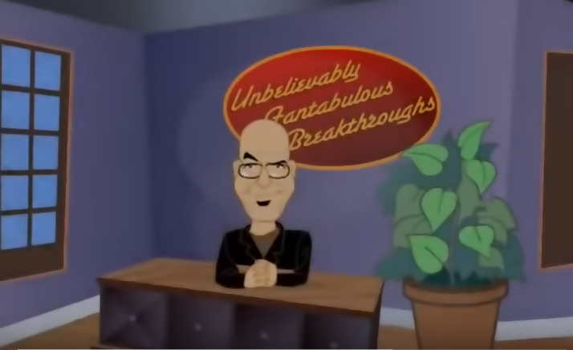
The smart consumer
Track Your Spending
Track o Matic https://www.youtube.com/watch?v=7EheCbT1iU4
Notes:
Use Sticky Notes. Ask everyone to write down at least 1 way to reduce impulse buying them put them up on the flip chart.

Slide 28
Need vs wants
Ask Yourself
When does a want become a need?
What motivates you to buy – advertising, friends, trendy styles, boredom?
Do your purchases make you happier?
What ‘needs’ do you have that are now collecting dust?
What ‘needs’ did you buy that you only used once?
What can you learn to live without??
Notes:
In this section we will be learning about the importance of the financial impact of our wants vs needs.
Ask: What is the difference between a want and a need? Open Discussion
Instructions: Using flipchart, engage participants to answer the questions and open discussion for idea sharing. In small groups, please go to one of the flip charts. Identify someone to the be the ‘writer’. There are 3 questions. Each group will respond to the question, write down idea and each group will report at the end. You will have 5 minutes to complete this.
NOTE: If a smaller group or time is being pressed, this activity can be done completely by the facilitator however engaging participants to do the writing is recommended.

Slide 29

NEEDS VS WANTS
What is
Your `Latte Factor´?
WHAT IS YOUR LATTE FACTOR
Designer coffees
Lunch in restaurants
Impulse buys
The latest, greatest [fill in the blank]
What are some of yours? How much are these ‘wants’ costing you?
“We’ve all got a latte factor, regardless of our income level.”
– David Bach

Slide 30
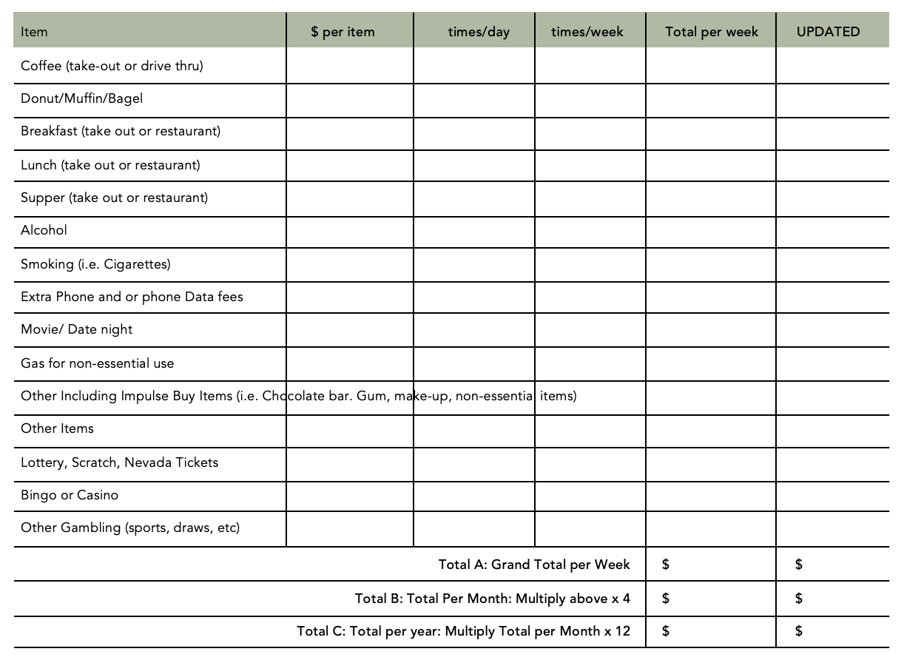
Needs vs wants-Your Latte Factor
Exercise: Immediate Savings
WHERE CAN YOU CUT SPENDING?
Notes:
Let’s take a look now at how you can start with immediate savings
Please go to page 4 in your handbook– Your Latte Factor Worksheet
You will see there is a second column. Now that you are more aware of your budget and spending, start identifying those ‘wants’ and remove them from your worksheet.
Only include items that you absolutely do not want to go without.
Use your calculator to get your new total.
Please take 5 minutes to do this.
Instruction: After 5 minutes is done: Now I want you to use your calculator and punch in the numbers from your first budget.
Subtract the amount of your NEW budget and put the total in the bottom right hand box that says SAVINGS.
Next I want you to multiply that amount by 4. This will show you how much money you will save in 1 month.
Take that new total and print the number into the box that says MONTLY SAVINGS.
Now take the monthly savings amount and punch it into your calculator. Multiply that times 12. This is your total savings in one year.
Put that new number into the box that says ANNUAL SAVINGS.
How many people have noticed they cut out a lot of their latte factor spending?
Please use a sticky note in front of you and write down the total amount of money that you would be saving in 1 year.
Once you are done, place it on the REDUCES LATTE FACTOR flip chart.
We will have 3 minutes to get this done.
Let’s take a quick look to see how much money people can be saving simply by cutting back a little on their ‘Latte Factor’ or those little wants each day.
Any comments? Allow 5 minutes .

Slide 31
NEEDS VS WANTS
Reduce Impulse Buying
Activity
Avoid unintended trips to the mall.
Do not go online buying or auction sites.
Pay cash or cheque for purchases and only carry the cash you are willing to spend.
Reduce available credit on your credit card and line of credit.
Leave credit cards at home.
Sleep on it and see if you still want it the next day before making the purchase.
Take baby steps and cut costs by increments.
Notes:
Use Sticky Notes. Ask everyone to write down at least 1 way to reduce impulse buying them put them up on the flip chart.

Slide 32






The froogle shopper
Introduction
WHAT IS FRUGAL SHOPPING?
  Couponing
  Phone Apps
  Price Matching
  Bundling Services
  Managing Debt
BIG IDEA: The more money at the end of the week means less debt and more fun!
Frugal shopping and living means you have more money in your pocket at the end of the week!
More money at the end of the week means less debt and more fun!
Notes:
Frugal shopping and living means you have more money in your pocket at the end of the week! More money at the end of the week means less debt and more fun! In this section we will be uncovering a few ways that you can become a frugal shopper and start with substantial savings. In this section we will be looking at:
Couponing
Phone Apps
Price Matching
Bundling Services
Managing Debt

Slide 33
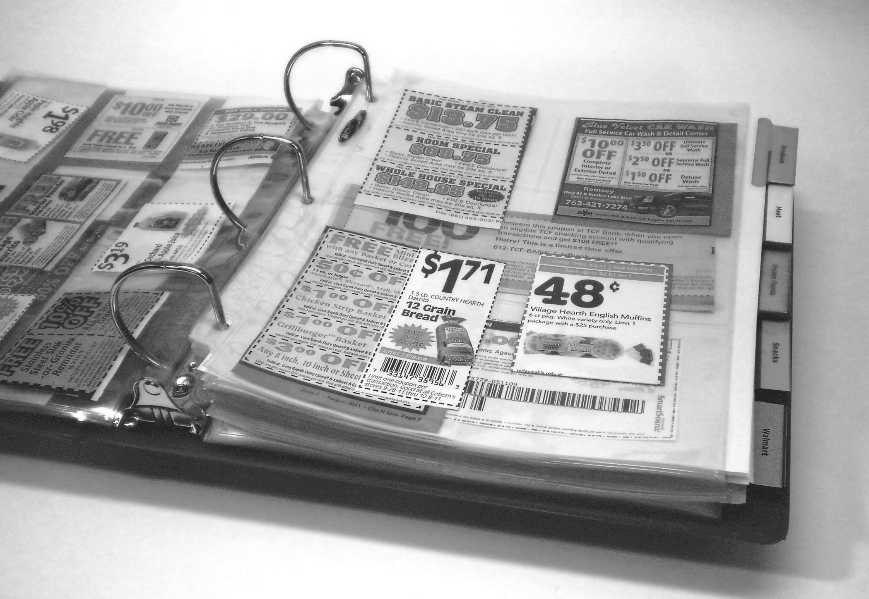
The froogle shopper:
Couponing
GETTING STARTED
A printer for printing online coupons
A laptop or computer
A plastic binder with dividers/labels
Store Flyers
A local newspaper (and/or any other mail subscriptions with coupons)
Cell phone for app couponing

Slide 34
The froogle shopper:
Couponing
ORGANIZING COUPONS
Organize your coupons in a way that works for you. Some people use a plastic binder method that sorts and divides coupons with tabs and pockets. Others like an accordion folder.
Note: put coupons that expire soonest at the front.
Sift through your coupon resources one by one (example: local newspaper, online, apps) then add relevant ones to your booklet.

Slide 35
The froogle shopPer:
Couponing
ORGANIZING COUPONS
The next time you shop, open your coupon binder and see if any of the coupon match items on your shopping list.
Note: the CartSmart and Flip apps can do this for you, but it is not all-inclusive in searching for all your local coupons that may be printed and available.

Slide 36


The froogle shopper:
Couponing
TIME COMMITMENT
Set aside and commit to a time-slot to search and find coupons you need. It doesn’t take that long when it has your full concentration but distractions can be frustrating and cause you not to bother.
If you can set aside 1 to 8 hours per week you can save $25 to $300 weekly, which is the same as making $25-50 per hour.
Ask yourself; is it worth the little effort?
1 to 8 hours
a week=
$25 t0 $300 weekly =
$25-50 per hour

Slide 37
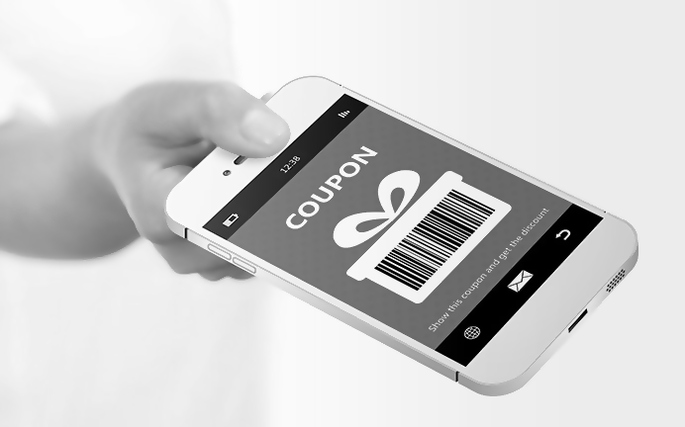
The froogle shopPer:
Couponing
FINDING COUPONS
Store Coupon walls/bulletin boards
Local newspapers
Store flyers
Direct-mailers
Magazines
Package inserts
Online at various store coupon websites like Coupon, PC Plus
Mail-in forms or sample requests that you receive for free in the mail
Coupon Websites
Coupon Phone Apps

Slide 38
The froogle shopper:
Couponing
STEPS
Sign up for your local newspaper or borrow one from a neighbour.
Check your store bulletin board for coupons before shopping (usually found near the entrance).
Join local coupon groups on Facebook to keep in the coupon know-how where you live.
Download coupon apps

Slide 39

The froogle shopper:
Couponing
STEPS
Use coupon websites to save or print off coupons for things you need
Go to your favorite product manufacturer websites and download or request discount coupons for items you need. Example: Kraft website often will have coupons for items like Kraft salad dressings, peanut butter

Slide 40
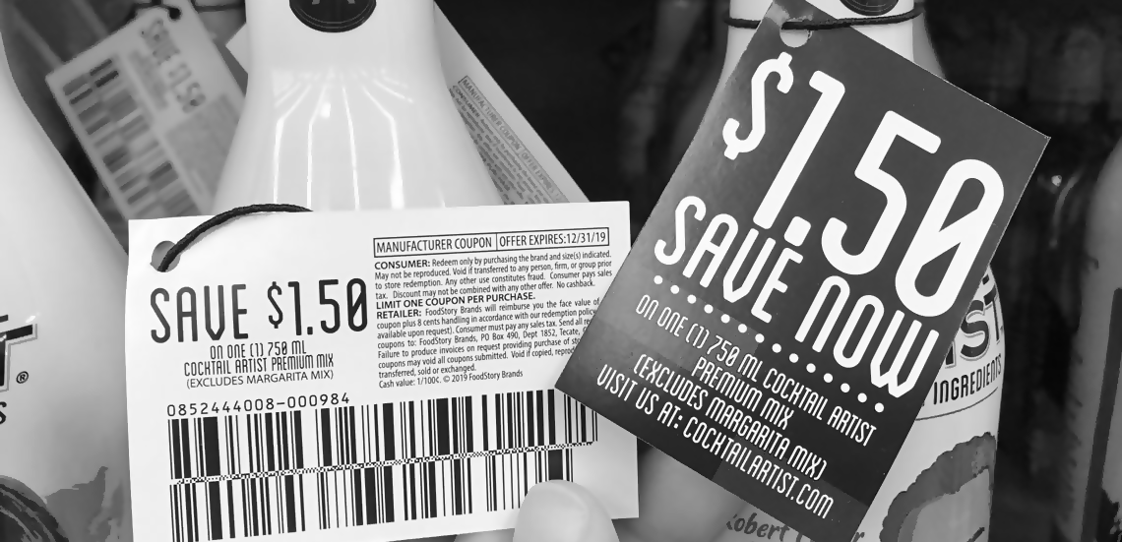
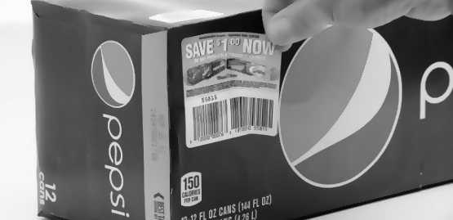
The froogle shopper:
Couponing
IN-STORE COUPONS
Hang Tag
Peeling Coupon

Slide 41
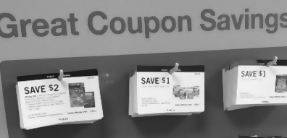
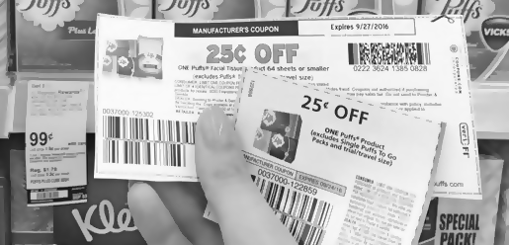
The froogle shoper:
Couponing
IN-STORE COUPONS
Display Coupons
Manufacturer Coupons

Slide 42
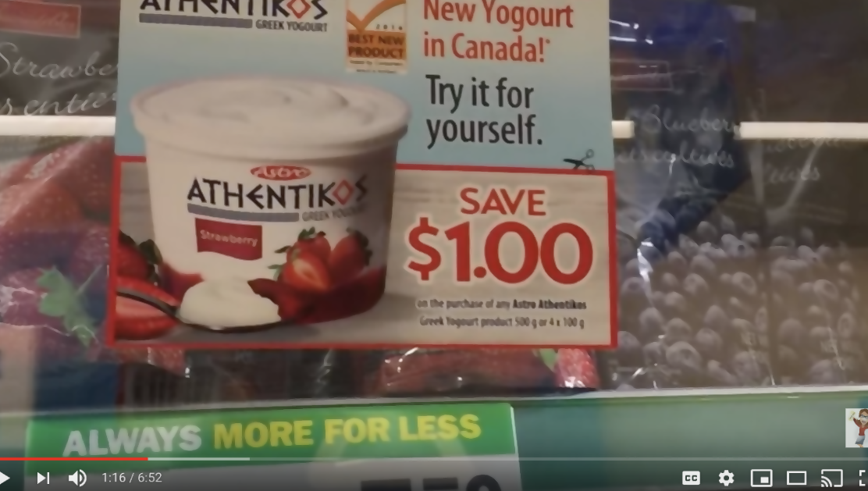
The froogle shopper:
Coupon Websites
Play this video called `Where to Find Coupons in Canada` (6 minutes 52 seconds):
https://www.youtube.com/watch?v=HnUuvVh-Uy0

Slide 43
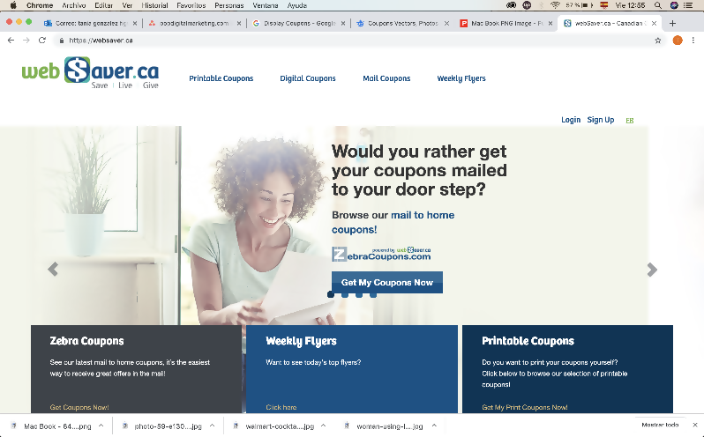
The froogle shopper:
Coupon Websites
Popular websites used for Canadian coupons online include:
  websaver.ca
  save.ca
  pgeveryday.caz
  smartsource.ca
  gocoupons.ca
  Checkout 51 (this is a phone app as well. You can also get cash back after shopping using your receipts)
Simply go to the websites and see which one most interests you. You may want to use more than one

Slide 44
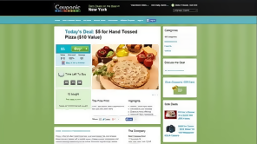
The froogle shopper:
Coupon Websites
Log in to a free account if you want to access the coupons.
Look at coupons, select the ones that you need. Download and save coupons in your app or phone.
You can use the coupons right away in the store as you are checking out at the cash, purchase directly through online stores, or submit your receipts to an online cashback service provider (described in the next section)

Slide 45
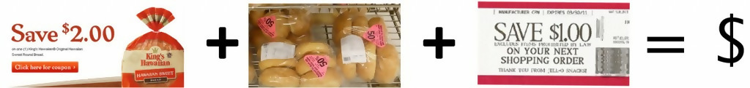



The froogle shopper:
What is Overage?
BIG IDEA: Understand what overage is and learn how to get the best value for your dollar
“Overage” happens when the value of your coupon exceeds the cost of the product you are buying.
This means you are either owed money in cash from the grocer, or get credit towards your current bill. So? How does this happen?

Slide 46
The froogle shopper:
How Overage Works
Combining a manufacturer coupon with a store coupon together.
Using a coupon on an item that has been reduced or put on clearance.
Apply ‘Catalina’ coupons to your bill. Example: Big chains like Walmart may offer ‘Save X dollars off your next purchase’ – these are also known as ‘Catalina’ coupons. If you owe $3 on your current bill and apply a $5 off Catalina (in store coupon), you will have a $2 overage. In essence, the store owes you $2 for purchasing that item.

Slide 47

The froogle shopPer:
Price Matching
Price-Matching: an item that you’re already
using a coupon on.
Example: Walmart is selling Oral B toothbrushes for .99 cents each. You price-match at another store to match the .99 cents Walmart cost, and apply the store’s coupon offer of buy 3 toothbrushes.
Doubling a Coupon: Coupons that double are Manufacturer coupons that you can find mostly in Sunday papers and for some extent also online. Example : when a shampoo bottle that’s normally priced at $3.50 goes on sale for $2.00, you can double a $1.00 manufacturer coupon and get it for free!

Slide 48
The froogle shopPer:
Price Matching
As a paying customer you have every right to do this and you should not feel as though you are inconveniencing anyone.
If the supervisor refuses, ask to speak to a manager. Remember to be polite as you will get more with sugar and kindness than with lemons or anger.
It is helpful if you have something in writing to defend your point, like a copy of their price matching or couponing policy. It is more likely your purchase will be allowed.

Slide 49
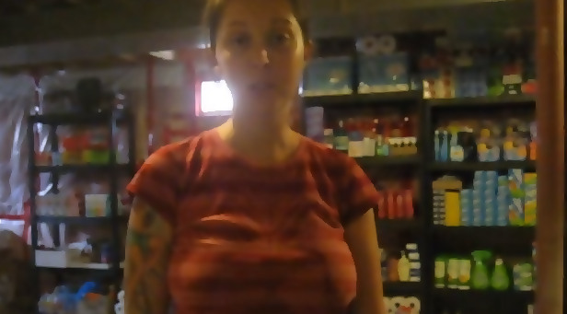
The froogle shopper:
Price Matching
In the event you exhaust every level at the store and you are still being refused a price match contact the company head office. If you believe you should not have been refused and were, they can either clarify your mistake or the store’s mistake.
Tutorial: https://www.youtube.com/watch?v=ApTrVXR2u6A

Slide 50

The froogle shopper:
Price Matching
  Best Buy (Low Price Guarantee)
  Canadian Tire (Price Matching Policy)
  Future Shop (Price Matching)
  Giant Tiger (Price Matching and Coupons)
  Home Depot (Price Matching)
  Home Hardware (Price Match Policy)
  Leon’s (Integrity Pricing)
  Shoppers Drug Mart (Coupon Policy)
  Staples (Price Matching)
  The Brick (Price Matching)
  Toys R Us (Price Match)
  Walmart (Price Match and Coupons)
  Metro (Coupon Policy)

Slide 51
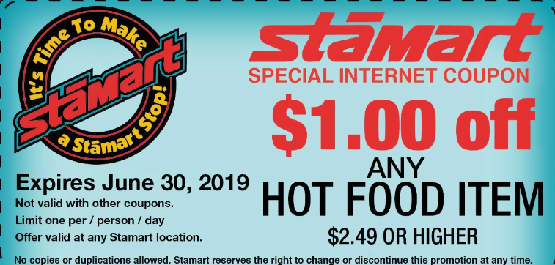
The froogle shopper:
Couponing Hiccups
Unless the coupon or sale says not valid with already discounted purchases, you are entitled to the saving.
Some stores will not pay overage in cash. Instead, you may receive an in-store credit for future purchases. Do not be afraid to ask.
You may need to fill the overage gap with ‘fillers’. If a store will not grant overage in cash or a shopping credit, you may need to select a few fillers – items that add up to the near or exact amount of the overage total.

Slide 52
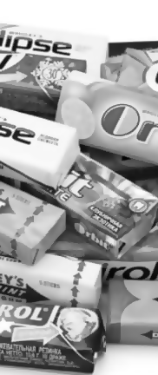
The froogle shopper:
Couponing Hiccups
Overage example: You have a $1 overage from coupons, you may need to grab an item that costs $1 (like gum) to fill the remaining overage amount. If you are savvy, you will have lots of overage and this will fund the rest of your regular grocery items like fruit or meat.
Stores may not allow you to use two coupons simultaneously, such as the manufacturer’s coupon and the store coupon.
A store may also not carry the product you have a coupon for. If you are making a far trip to purchase an essential or popular item, you may want to phone ahead to see if the store has your item in stock.

Slide 53
The froogle shopper:
Phone Apps
Phone apps can save you 20-70% off purchases.
These apps can be downloaded for free to your phone or accessed online.
Phone shopping apps are like using virtual store flyers, weekly circulars or coupons.
Easily downloaded to your phone or accessed online.
https://www.youtube.com/watch?v=8JjVLGSTqFU
Start time: 49 seconds

Slide 54
The froogle shopper:
Phone Apps
These apps include local flyers
Many retail stores features on these apps also have websites where you can purchase your items online and take advantage of weekly sales and pick up in your local store later.
Flyer ads have start and end dates for these sales.
Easy and reduces couponing time
You can price match, use coupons, purchase online
or submit receipts to get actual cash back from your shopping.

Slide 55
The froogle shopper:
Phone Apps
Popular Canadian phone apps include: Flip App,
Checkout 51, CartSmart and Snap
Flip App Tutorial:
https://www.youtube.com/watch?v=GEFE1SBIiY8
Checkout 51 Tutorial: https://www.youtube.com/watch?v=pfkBo6QhVhM
Snap by Groupon Tutorial: https://www.youtube.com/watch?v=sKIPRbTjixo

Slide 56
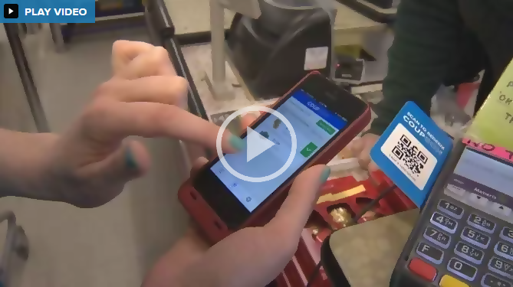
The froogle shopper:
Cashback
Play this online demonstration. Click on link, scroll half way down the page and play video:
https://globalnews.ca/news/2498687/interest-in-food-coupons-flyers-and-money-saving-apps-soars/ (2 minutes 52 seconds)

Slide 57

The froogle shoper:
Learn about Cashback
Whether shopping in the store or online you can sign up (at no charge) to a FREE CASHBACK provider website. Through these providers you can get a percentage of money back from your online shopping – even on sale purchases.
Sign up to a Cashback provider.
In Canada a few popular
ones include:
  Ebates.ca
  Great Canadian Rebates
  (give you $2 for signing up)
  CartSmart
  Zweet

Slide 58
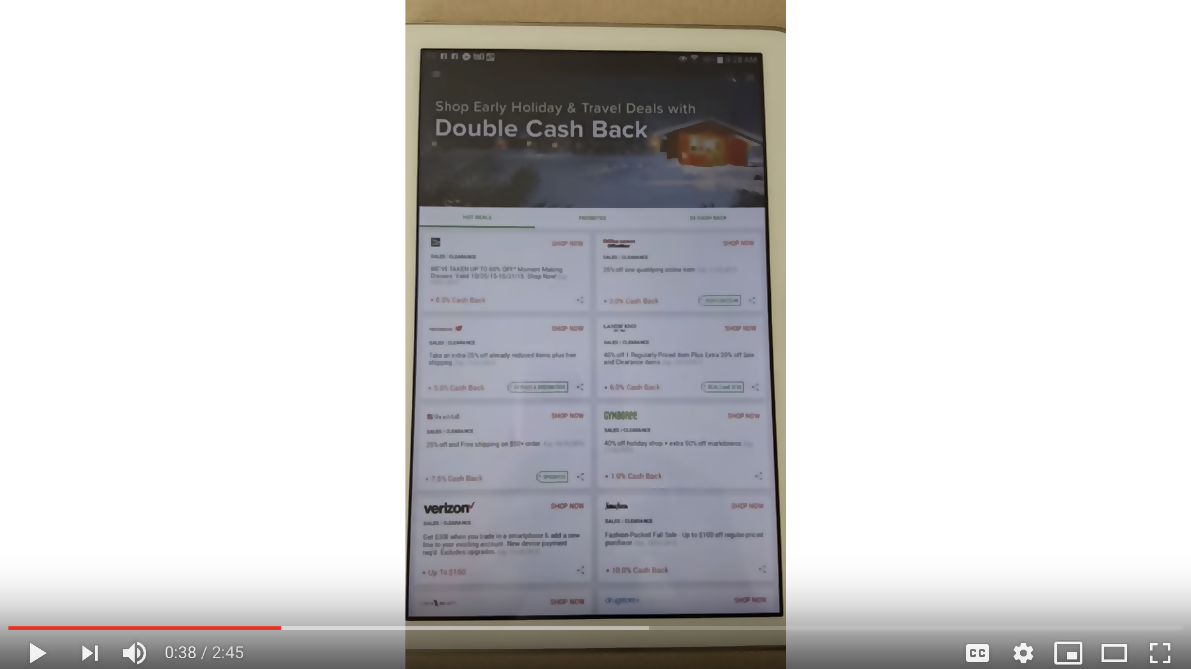

The froogle shopper:
Rakuten: Cashback
Instruction: Option to play this video if you have internet access: https://youtu.be/ldHrYv0mcVs

Slide 59

The froogle shoper:
Ebates: Cashback
Sign up and log in to your cashback provider like ebates.ca. Select your online store i.e. Amazon.ca.
You can cash out once you meet a minimum amount.

Slide 60
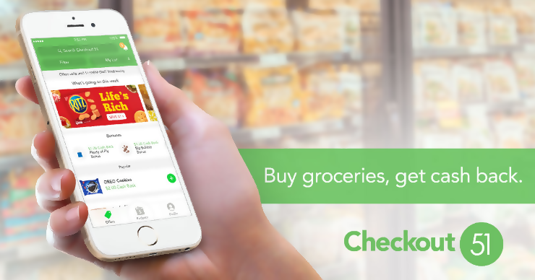
The froogle shopper:
Checkout 51: Cashback
Open and log in to your free account.
Search and highlight coupons you want.
Go shopping in your local stores and keep all receipts.
Once you are done, take a snapshot of your receipts and submit them.
Video Tutorial: https://www.youtube.com/watch?v=Wi3Yl0aLfts

Slide 61
The froogle shoper:
Final Couponing Tips
Only buy what you really need. Don’t buy something because you have found a coupon for it.
It pays to check. A brand name with a coupon is not always cheaper than discount brands. Buying the same item at a more expensive store that accepts your coupon could still be more expensive.
Grab Many: See a free coupon booklet or magazine? Don’t just grab one, grab several! Even if coupons are limited to one per transaction, you can use them again on another trip. Just watch for the expiry date.

Slide 62

The froogle shoper:
Final Couponing Tips
Write to Manufacturers: If you are really hoping to get a better deal, write or email the manufacturers of the products you love. You may likely get some coupons out of appreciation. Extreme couponers will attest that this works quite often.
Know the terms and conditions of your coupon before going out so you are prepared to explain the coupon at check-out if needed. Shoppers behind you will also be grateful if you know what you are doing and are not holding up line.

Slide 63

CREDIT CARD AND debt MANAGEMENT
BIG IDEA: Credit is a helpful tool but it can get out of control.
  Mortgage
  Car loan
  Personal loans
  School loan
  Credit cards
  Line of credit
MANAGING DEBT

Slide 64

Managing debt:
Warning Signs: Checklist
You use your credit cards as a necessity instead of a convenience.
You use credit or cash advances for your daily living expenses.
You miss payment or due dates.

Slide 65
Managing debt:
Warning Signs: Checklist
You’re near the credit limit on most of your cards.
You borrow from one card to pay another.
You You transfer balances every few months just before the introductory offer expires.

Slide 66
Managing debt:
Taking Control: Helpful Hints
Use savings to pay off balances.
Pay down your highest interest rate debts first.
Switch to less expensive credit cards.
Call creditors to negotiate lower interest rates.

Slide 67
Managing debt:
Taking Control: Helpful Hints
Start automatic/online bill payment to stay on schedule.
Avoid “buy now, pay later” offers.
Get a consolidation loan to make one low-interest payment.
Leave your credit card at home and don’t use it to buy anything if you are in debt.

Slide 68
Managing debt
Credit Tips
Shop around for loans no matter how long you have used the same bank.
Compare bank loans credit card
interest rates.
Don’t accept your first offer.
Keep within your budget.
Get out of
debt

Slide 69
Managing debt
Credit Tips
Borrow only what you can afford to pay back in full every month and on time.
Pay back more and pay more often.
Additional loan payments mean you’ll pay it off sooner and pay less interest.
Credit Cards: Keep your balance at ZERO every month. If you can’t do this, you cannot afford the credit card and cannot afford the purchase.
Get out of
debt

Slide 70
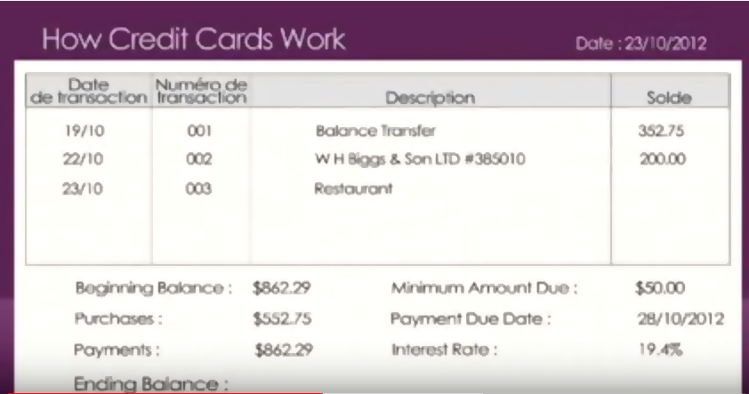
Managing debt:
Credit Cards
Tutorial: 3 min https://www.youtube.com/watch?v=bOFrH1Dzgfo

Slide 71
Managing debt:
Credit Cards: Helpful Tips
Pay the balance in full each month.
If you can’t pay it in full, pay as much as you can.
Don’t make only the minimum payment.
If you always carry a balance, get a low-rate card.
Transfer the balance to a line of credit with a lower rate.
Pay a few days before the due date.

Slide 72
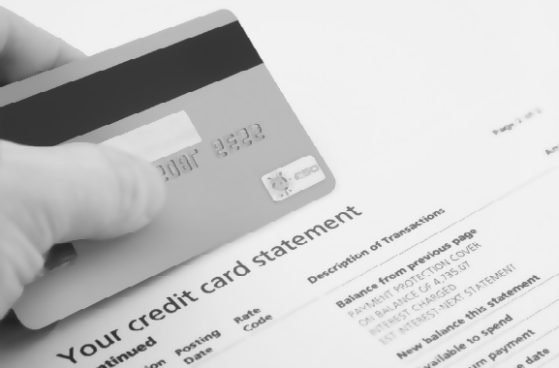
Take Control of Debt
Managing debt:
Make more than the minimum payment
Use savings to pay off balances owed
Pay down your highest interest rate debts first
Switch to less expensive credit cards
Call creditors to lower interest rates
Start automatic bill payments to stay on schedule
Avoid “buy now, pay later” offers, even if the offer is interest free for a period of time
Get a consolidation loan to make one lower interest payment

Slide 73

Managing debt:
Getting help
Financial planner or advisor
Credit counseling: you will be put on a debt management program (average duration is four to five years).
Consumer proposal through a Licensed Insolvency Trustee (average duration to discharge is four to five years).
Bankruptcy (can be discharged in one to two years).
Information on credit and debt assistance is provided on page 20 in the participants’ Handbook.

Slide 74

Protecting yourself:
Fraud & Identify Theft
Your cell number
has won
$850.00 USD on
Nelson Foundation for claims email:
Rafw4-
rewards0@hac.com
or call +21145993462. No ticket was sold for this draw
WHAT TO AVOID
Identity Theft
Lottery Scams
Phishing and Phoney Emails
Overpayment Scam
How to Protect Yourself
What to do
  MOBILE PHONE SCAMS

Slide 75

Protecting yourself:
BIG IDEA: The Best protection is knowing what to avoid.
DID YOU KNOW?
In 2014, the total reported dollar loss by victims of identity theft in Canada was about:
$3 million
$18 million
$10.5 million
Answer: c) Canadians reported losses of $10.5 million as a result of identity theft in Canada in 2014. These figures are probably low, since losses to fraud often go unreported.
Notes:
Answer: Answer: c) Canadians reported losses of $10.5 million as a result of identify theft in Canada in 2014. These figures are probably low, since losses to fraud often go unreported. Source: Canadian Anti-Fraud Centre Annual Statistics Report, 2014)

Slide 76
Protecting yourself:
Transfer Fund Scams

Slide 77
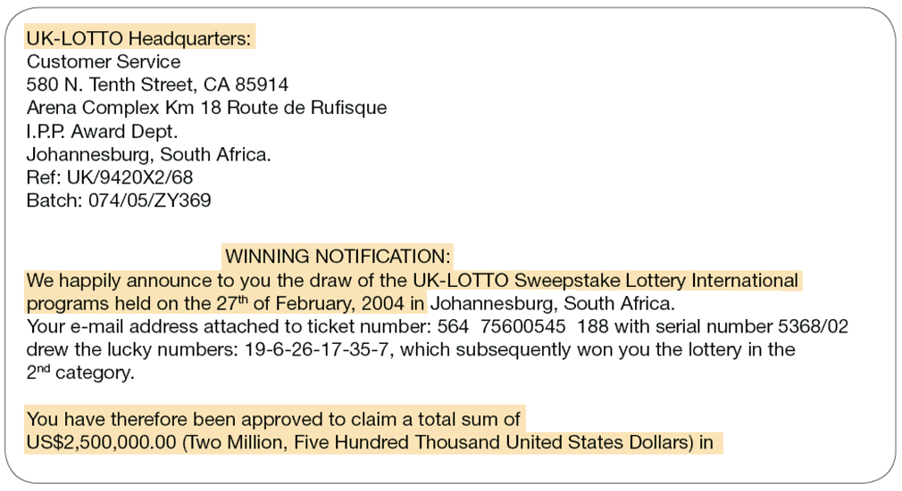
Protecting yourself:
Lottery Scams

Slide 78
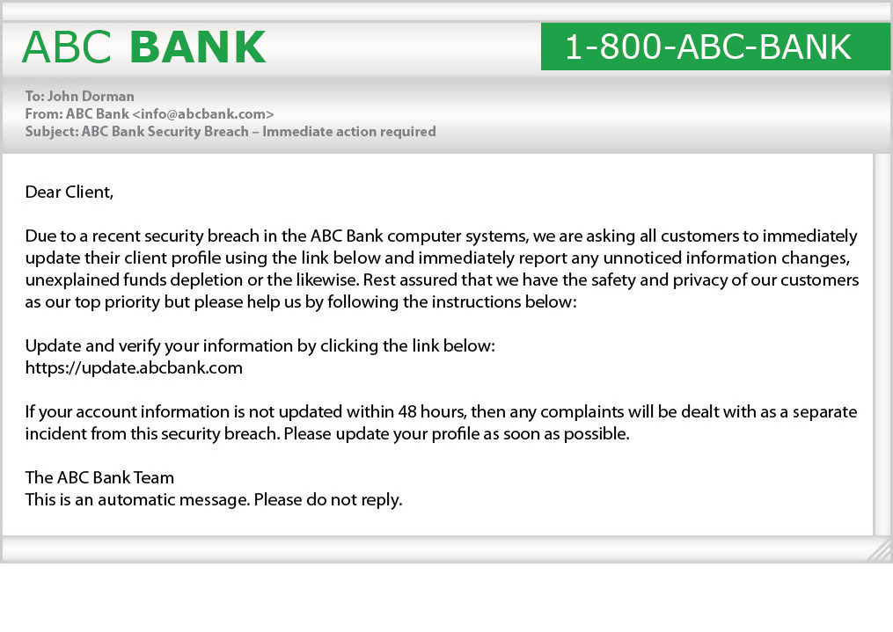
Protecting yourself:
Phony Web Scams

Slide 79
Protecting yourself:
Phishing Blackmail Scams
-----Original Message-----
From: Chelsea [mailto:info]
Sent: August-08-18 12:34 PM
To: Mary Smith
Subject: Marys@google.com:smith
It appears that, (smith), is your password. You might not know me and you are most likely wondering why you're getting this e-mail, right?
in fact, I put in place a viruses on the adult videos (adult porn) web-site and guess what happens, you visited this site to have fun (you know what I am talking about). Whilst you were watching videos, your internet browser started out functioning as a RDP (Remote Access) which gave me accessibility of your screen and web cam. after that, my software programs obtained your entire contacts from the Messenger, Microsoft outlook, FB, along with emails.
What did I actually do? I made a double-screen video. First part shows the recording you were seeing (you have got a good taste haha . . .), and 2nd part shows the recording of your web cam.
exactly what should you do?
Well, in my opinion, $11000 is really a fair price for our little hidden secret. You will make the payment by Bitcoin (if you don't know this, search "how to buy bitcoin" search engines like google).
BTC Address: 1NmeBjhHD1zunyxpoT4kwCCwe4DvLPgNVX
(It's case sensitive, so copy and paste it)
Very important:
You have 5 days to make the payment. (I've a completely unique pixel in this e-mail, and at this moment I know that you've read through this email message). If I don't get the BitCoins, I will certainly send your video recording to all of your contacts including relatives, colleagues, and so forth. Having said that, if I get the payment, I'll destroy the video immidiately. If you need evidence, reply with "Yes!" and I will undoubtedly send out your videos to your 6 contacts. It is a non-negotiable offer, that being said don't waste my personal time and yours by answering this message.

Slide 80
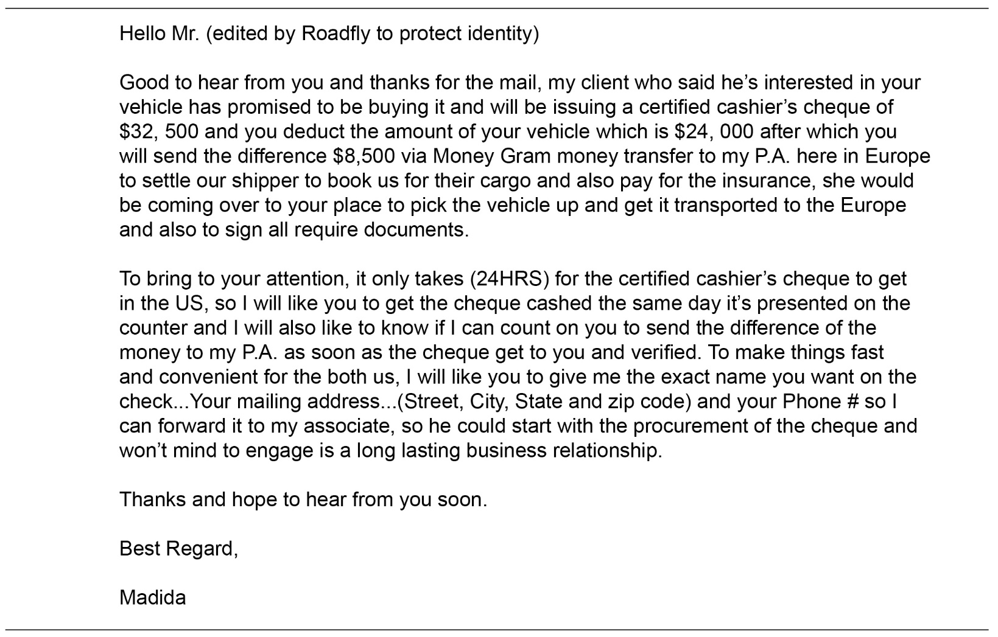
Protecting yourself:
Overpayment Scams

Slide 81
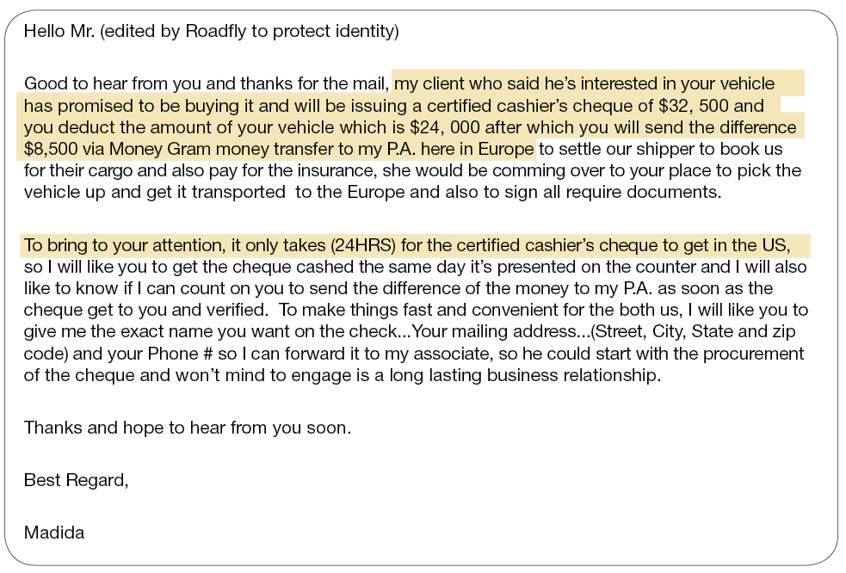
Protecting yourself:
Sales Scams

Slide 82

Protecting yourself:
Employment Scams
Offer considerable pay with few or no duties.
Promise payment of wages in cash.
Contain no physical address or contact person.
Require you to open a new bank account or accept company cheques to ‘test’ a wire transfer service.

Slide 83
Protecting yourself:
Employment Scams
BEING RECRUITED FOR AN ILLEGAL JOB
  These work-at-home offers say they offer a good salary for you receiving packages at your house and reshipping them overseas. You pay out-of-pocket to ship the packages, get paid with a fake cheque, and the packages were paid for with stolen and fake credit cards.

Slide 84
Protecting yourself:
Employment Scams
IDENTITY THEFT THROUGH JOB APPLICATIONS.
  Thieves request your personal information ‘for the human resources department’ and use it to steal your identity.

Slide 85
Protecting yourself:
Employment Scams
BOGUS EMPLOYMENT FEES
  Someone promises you a job, but only if you pay a fee for processing, administration or uniforms up front.

Slide 86




Protecting yourself:
Don’t share personal information freely.
Destroy documents with personal information.
Keep your wallet or purse safe.
What to Do
Notes:
Put your participants in equal groups. Use flip charts and have them list as many ways as possible on how to protect themselves from Identify Theft. Allow 10 minutes. Have each group share their findings. Once all groups have shared, review the bullets on this slide and the next 2 slides as a final review of this section. This segment should take 45 minutes.

Slide 87


Protecting yourself:
Don’t carry ID you don’t need (such as SIN).
Lock your household mailbox if possible.
Never give out the 3 digit # on the back of your credit card over the phone or for any online purchases.
What to Do
Notes:
Put your participants in equal groups. Use flip charts and have them list as many ways as possible on how to protect themselves from Identify Theft. Allow 10 minutes. Have each group share their findings. Once all groups have shared, review the bullets on this slide and the next 2 slides as a final review of this section. This segment should take 45 minutes.

Slide 88
Protecting Yourself
LIMIT THE NUMBER OF CREDIT CARDS
YOU HOLD

Slide 89
Protecting Yourself
CHECK YOUR CREDIT REPORT
ONCE A YEAR.
This is free if you contact the credit bureau
There is a fee, if you want it immediately

Slide 90
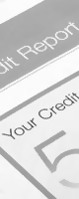
Protecting yourself
Make sure websites are secure before transmitting any of your personal information.
Delete emails that ask for personal information.
Spot fake companies. If an email starts with Dear Customer it is most likely fake. Any company that you do business with will include your proper name

Slide 91

Protecting yourself
Keep your computer passwords safe.
Don’t give telemarketers any of your personal information.
Destroy old documents that contain identity information.
Be skeptical – if an offer sounds too good to be true, it is!
Save paper bank records for at least a year.
  When in doubt call the police fraud line in your area to ask question or file reports.

Slide 92
Protecting yourself
Write to Manufacturers: If you are really hoping Keep computer firewalls and spyware up-to-date.
Make sure websites are secure before transmitting any of your personal information.
Delete emails that ask for personal information.
Spot fake companies. If an email starts with Dear Customer it is most likely fake. Any company that you do business with will include your proper name

Slide 93
Protecting yourself
Limit the number of credit cards you hold.
Check your credit report once a year. This is free if you contact the credit bureau once a year and ask them to mail it to you. If you want an electronic instant copy, there is usually a fee.
Keep computer firewalls and spyware up-to-date.

Slide 94
Protecting yourself
REVENUE CANADA DOES NOT EMAIL CITIZENS REQUESTING YOU SEND THEM MONEY OR THAT THEY HAVE A REFUND CHEQUE FOR YOU. IF YOU GET ONE OF THESE BE SUSPICIOUS AND DO NOT RESPOND.
IF IN DOUBT CONTACT REVENUE CANADA DIRECTLY FOR ASSISTANCE AND/OR TO REPORT THE
SUSPICIOUS EMAIL.

Slide 95
Protecting yourself:
I’ve been hacked, now what?
Contact your financial institution(s) and credit card companies immediately.
Notify Canada’s credit bureaus (Equifax Canada at www.equifax.ca and TransUnion Canada at www.transunion.ca).
Notes:
Open this to discussion with the group if there is enough time or you can review these few bullets quickly and move one. This section should take no more than 5 minutes.

Slide 96
Protecting yourself:
I’ve been hacked, now what?
Contact the Canadian Anti-Fraud Centre
Notify your local police as soon as you are aware
of it.
  A list or Fraud Resources has been provided at the end of your handbook on page 7.
Notes:
Open this to discussion with the group if there is enough time or you can review these few bullets quickly and move one. This section should take no more than 5 minutes.

Slide 97

Summary and wrap-up:
Lessons Learned
Keep track of your income and your expenses in a budget.
Save money by questioning your bills and reducing your “latte factor.”
Shop around for the best banking accounts, credit cards and service plans.
Pay all debts on time and in full, if possible.
Using sales, coupons, apps and price matching
Secure your identity and avoid identity theft.
If it sounds too good to be true, it probably is

Slide 98
Making Cents:
Benefits of Financial Literacy
Control your financial future.
Achieve your life goals
Provide for yourself and your family.
Be a smarter consumer.
Reduce stress and sleep better at night.
Be more confident in your ability to manage your finances and daily living expenses

Slide 99

wrap-up
PLEASE COMPLETE THE
PARTICIPANT EVALUATION FORM
THANK YOU
Notes:
Your feedback is important to us so we can continue to improve and offer future workshops and training that is relevant to you.
Please complete the participation evaluation form that has been provided and kindly hand it in before you leave.
Thank you for your time.

Slide 100


